Slide 1
Campaign Performance Analysis: Unlocking Revenue Potential
Serena Langiano

Slide 2




Methodology
Defining the problem and the objectives – Articulating the goal of the analysis and what insights are needed. Python was the tool chosen to perform the analysis
Data Cleaning – Removing missing values, converting dates in datetime format, removing punctuations, numbers and gibberish from columns containing text, converting Chinese characters in English. Libraries used: pandas, Translator, enchant, re
Campaign Performance
Analysis
Feature Engineering – Creating a Machine Learning model (Classifier) to associate job titles with professional domains. A dataset listing jobs across multiple domains was used to train both SGD and MLP Classifiers and the algorithm with higher accuracy was selected. Libraries used: scikit-learn
Statistical Analysis and Visualization – Computing and visually representing the most useful insights. Libraries used: pandas, NumPy (analysis), matplotlib and seaborn (data visualization)
Interpretation of Results – Interpreting the findings from the analysis to understand what worked and what didn’t in each campaign

Slide 3
Campaign 1

Slide 4



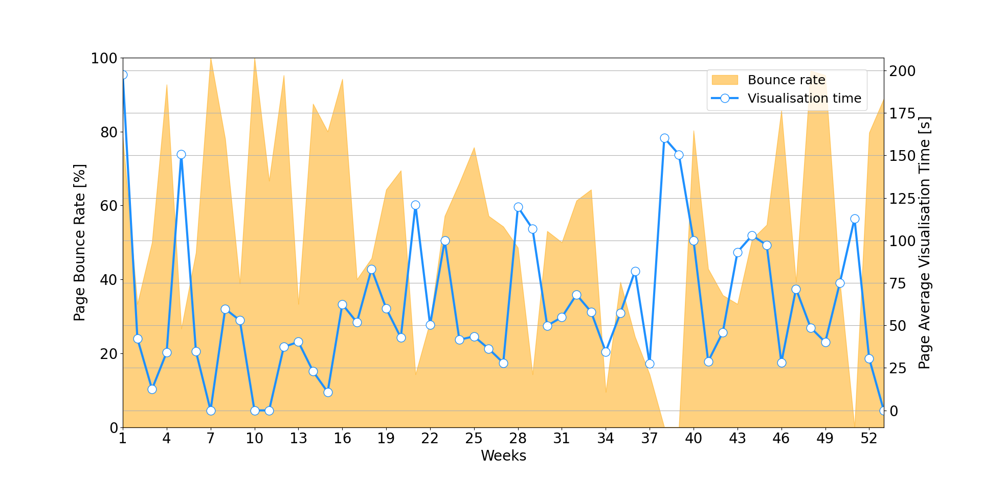
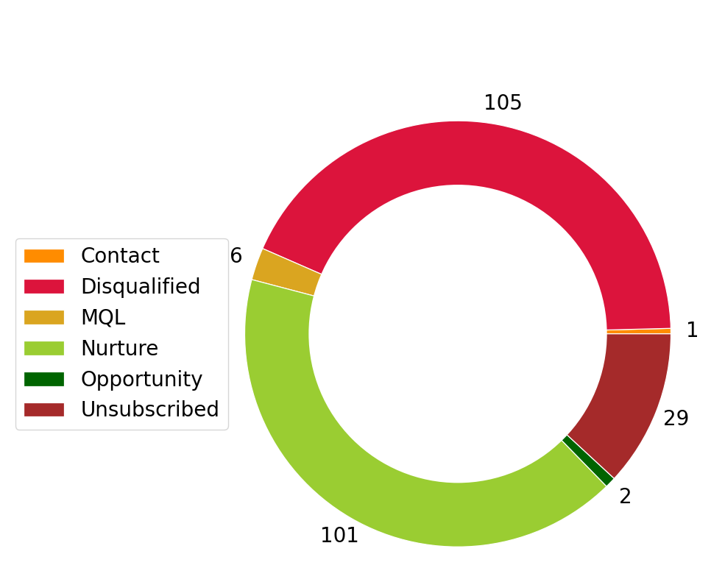
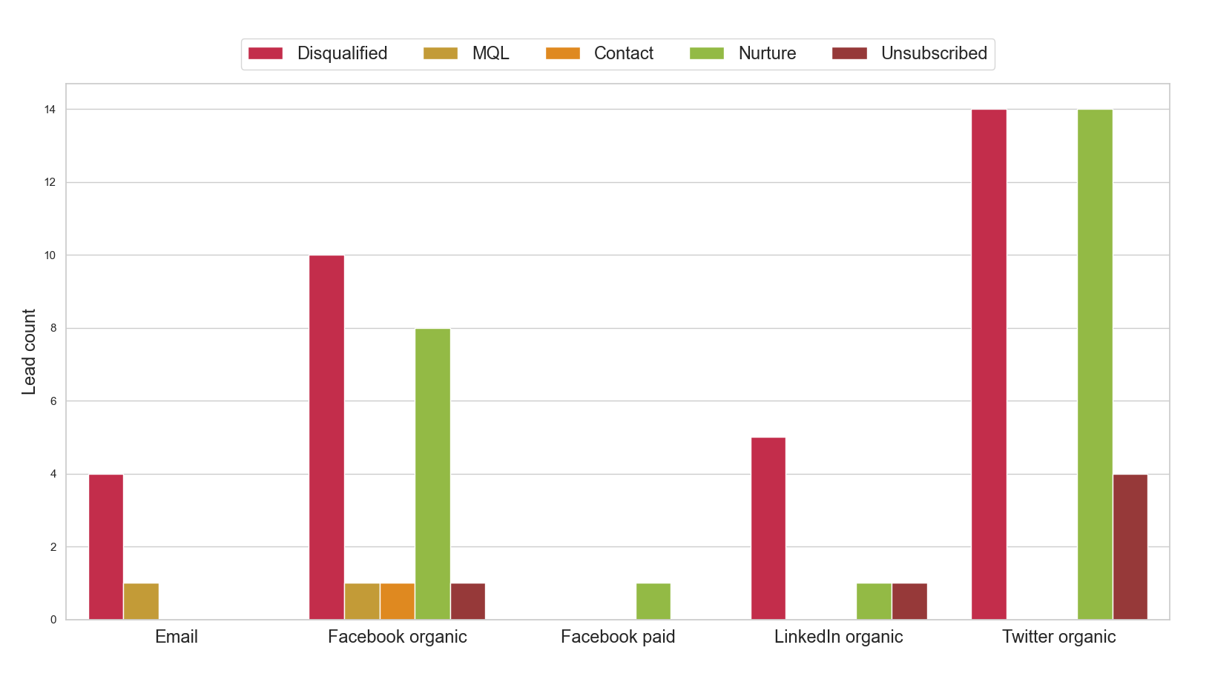
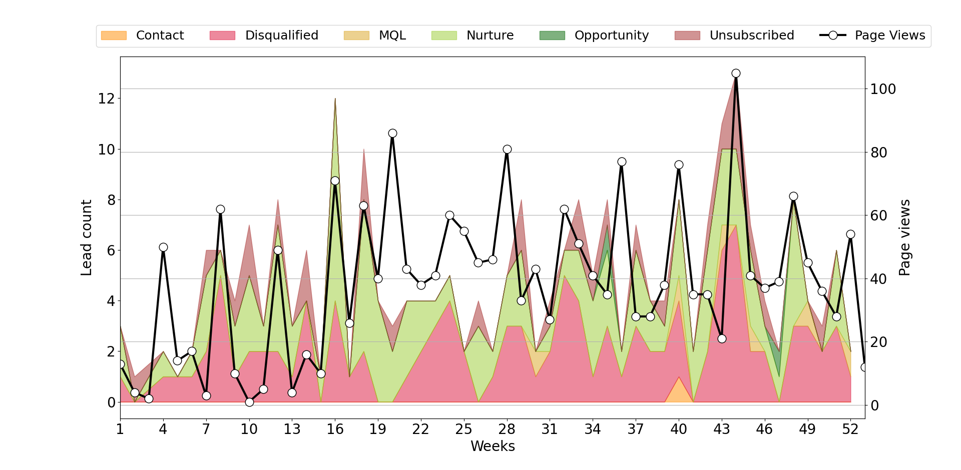
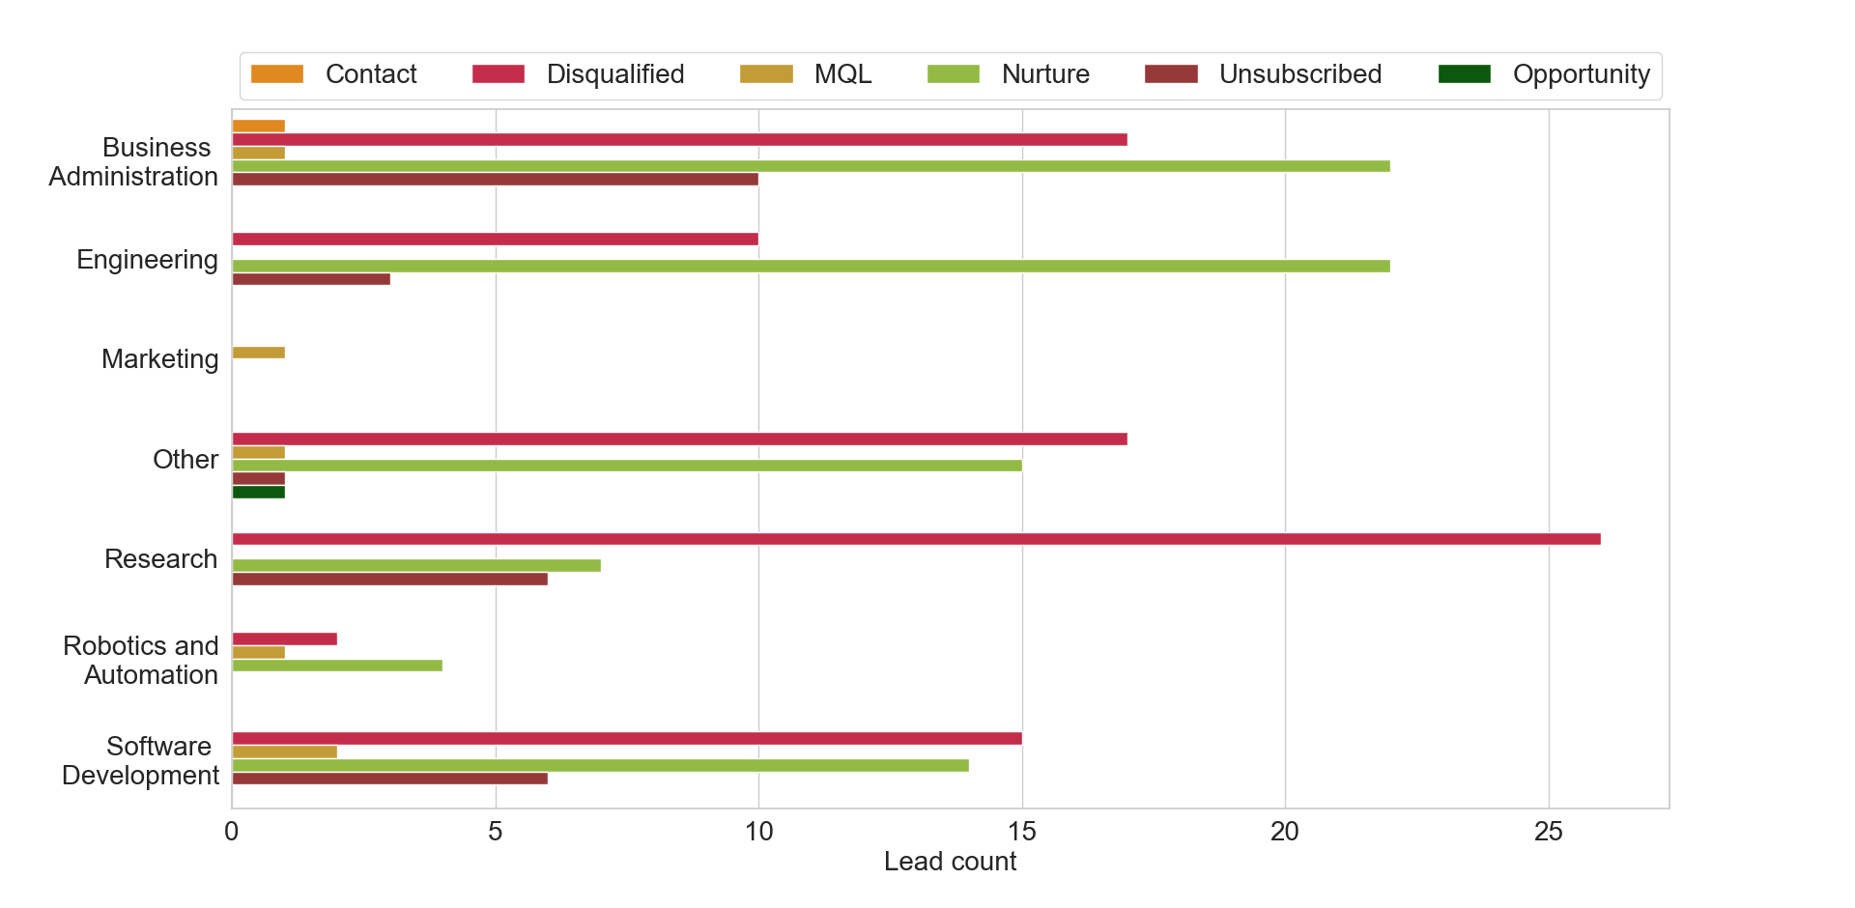
PAGE VIEWS
PAGE VIEWS
LEADS
AVG SESSION
BOUNCE RATE
2048
2048
244
00:01:08
51.22%
AVG VISUALIZATION TIME And BOUNCE RATE Per Week
LEADS Status Breakdown
LEADS Status Per SOURCE
PAGE VIEWS And Acquired LEADS Per Week
LEADS Status Per Professional Domains
Country | MQL | Nurture | Opportunity | Total
US | - | 19 | - | 19
GB | 1 | 5 | - | 6
IN | - | 6 | - | 6
DE | - | 4 | 1 | 5
KR | - | 5 | - | 5
Country | Disqualified | Unsubscribed | Total
US | 17 | 6 | 23
DE | 9 | 3 | 12
IN | 8 | 3 | 11
CA | 3 | 2 | 5
AU | 4 | 1 | 5

Slide 5
What worked and what didn’t
Nurture leads coming from organic search on Facebook and Twitter
55% of total leads are Disqualified, Unsubscribed and Contact
Good targeting, as a high number of Nurture leads belongs to BA, Engineering and SWD
Targeting didn’t work as well for Robotics and Automation, which collected few quality leads

Slide 6
Campaign 2

Slide 7
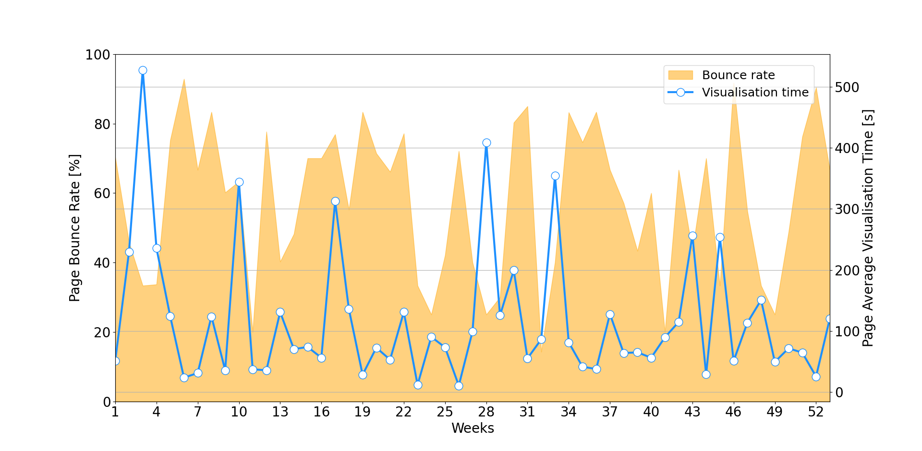
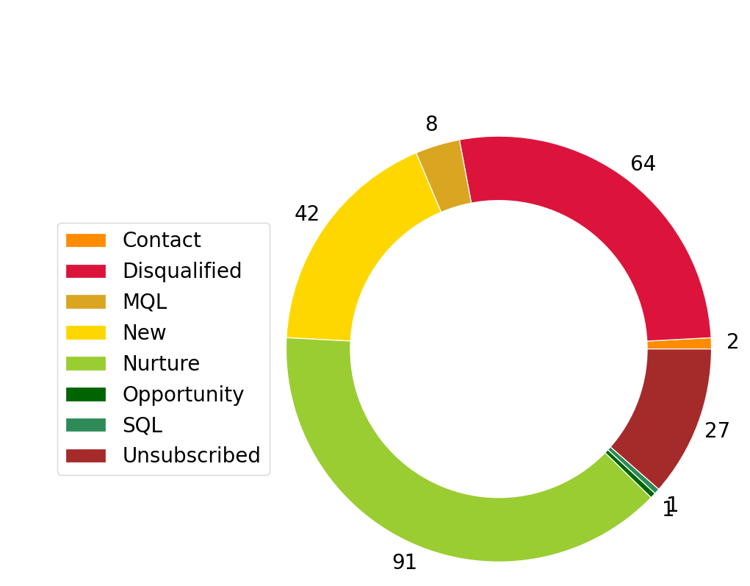
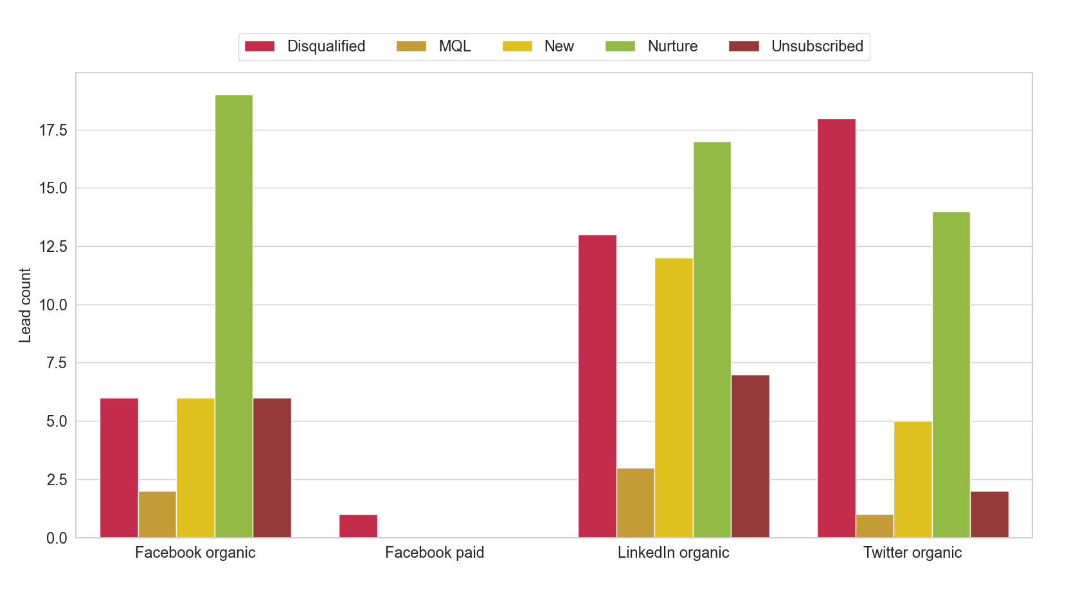
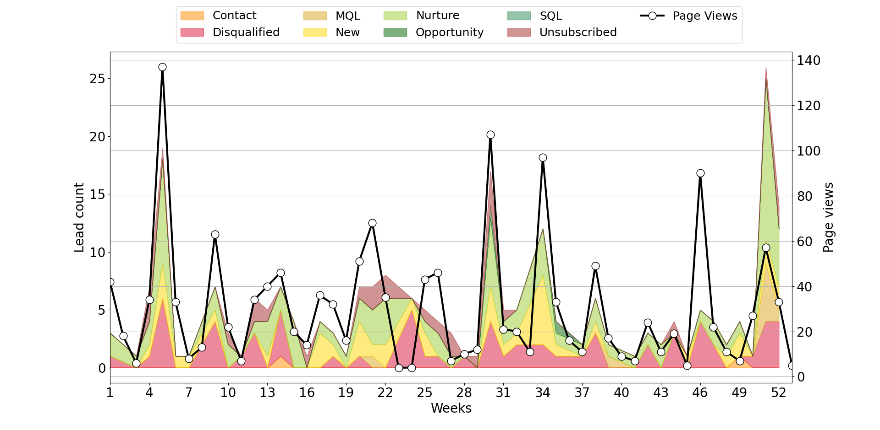
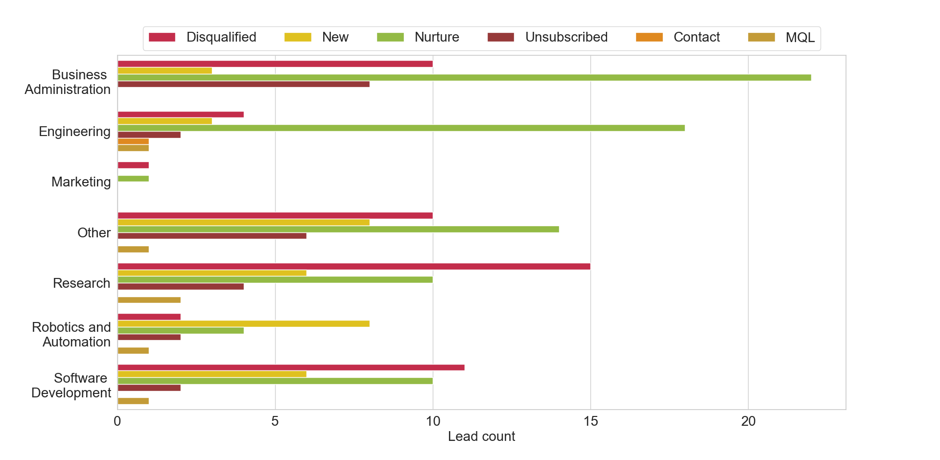
PAGE VIEWS
PAGE VIEWS
LEADS
AVG SESSION
BOUNCE RATE
1610
2048
236
00:01:52
59.33%
AVG VISUALIZATION TIME And BOUNCE RATE Per Week
LEADS Status Breakdown
LEADS Status Per SOURCE
PAGE VIEWS And Acquired LEADS Per Week
LEADS Status Per Professional Domains
Country | MQL | New | Nurture | SQL | Total
US | 2 | 8 | 14 | 1 | 25
FR | 1 | 4 | 7 | - | 12
IN | 1 | 3 | 6 | - | 10
GB | 1 | 3 | 5 | - | 9
PT | - | 3 | 2 | - | 5
Country | Disqualified | Unsubscribed | Total
US | 9 | 4 | 13
IN | 8 | 2 | 10
GB | 4 | 1 | 5
IT | 1 | 2 | 3
FR | 3 | - | 3

Slide 8
What worked and what didn’t
Higher average visualization time, which might relate to 1) higher interest in the topic and/or 2) better targeting
Quality leads are coming from organic search on Facebook, Twitter and LinkedIn
60% quality leads
Good targeting, as a high number of quality leads belongs to professional domains of interest

Slide 9
Campaign 3

Slide 10
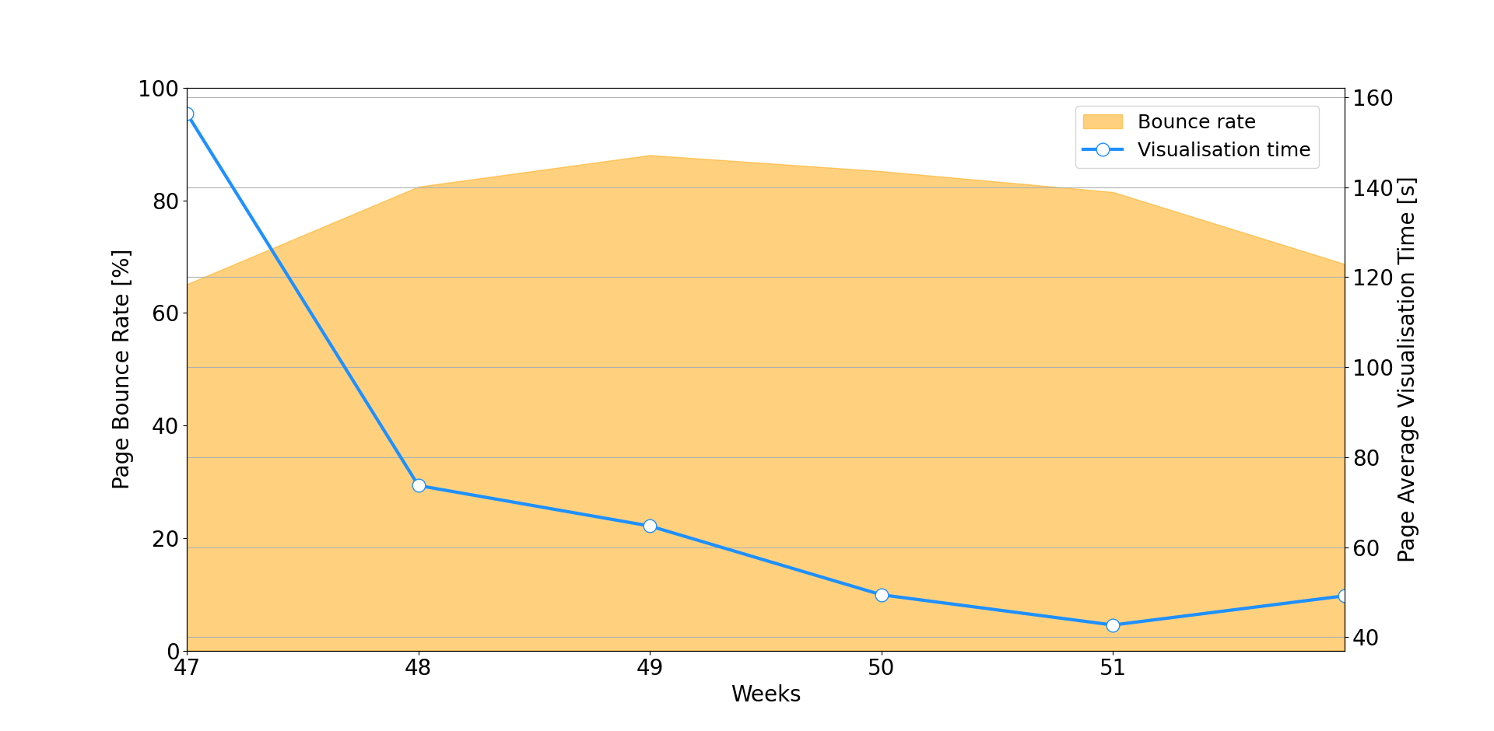
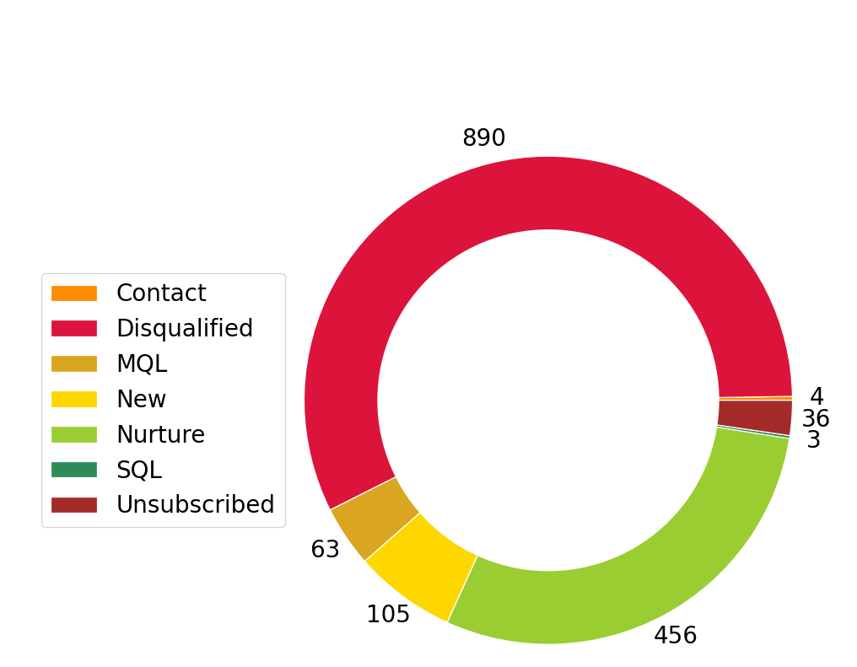
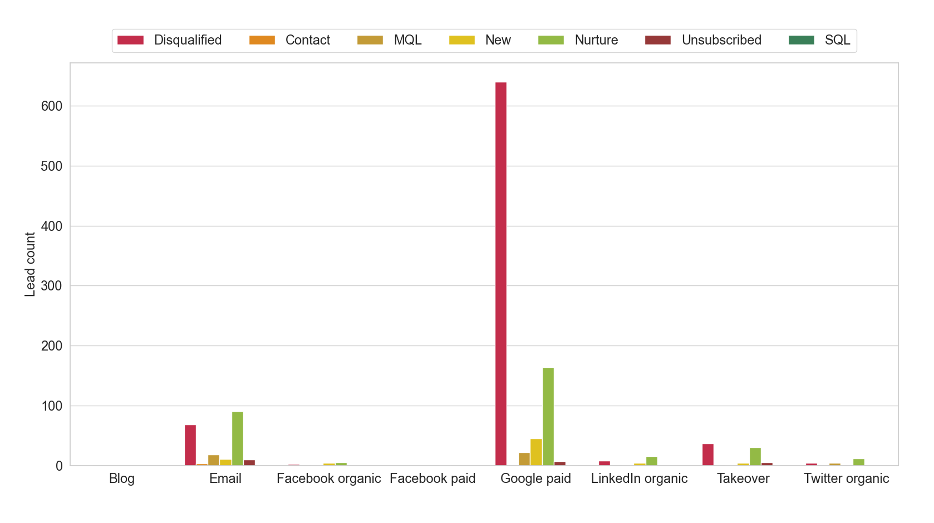
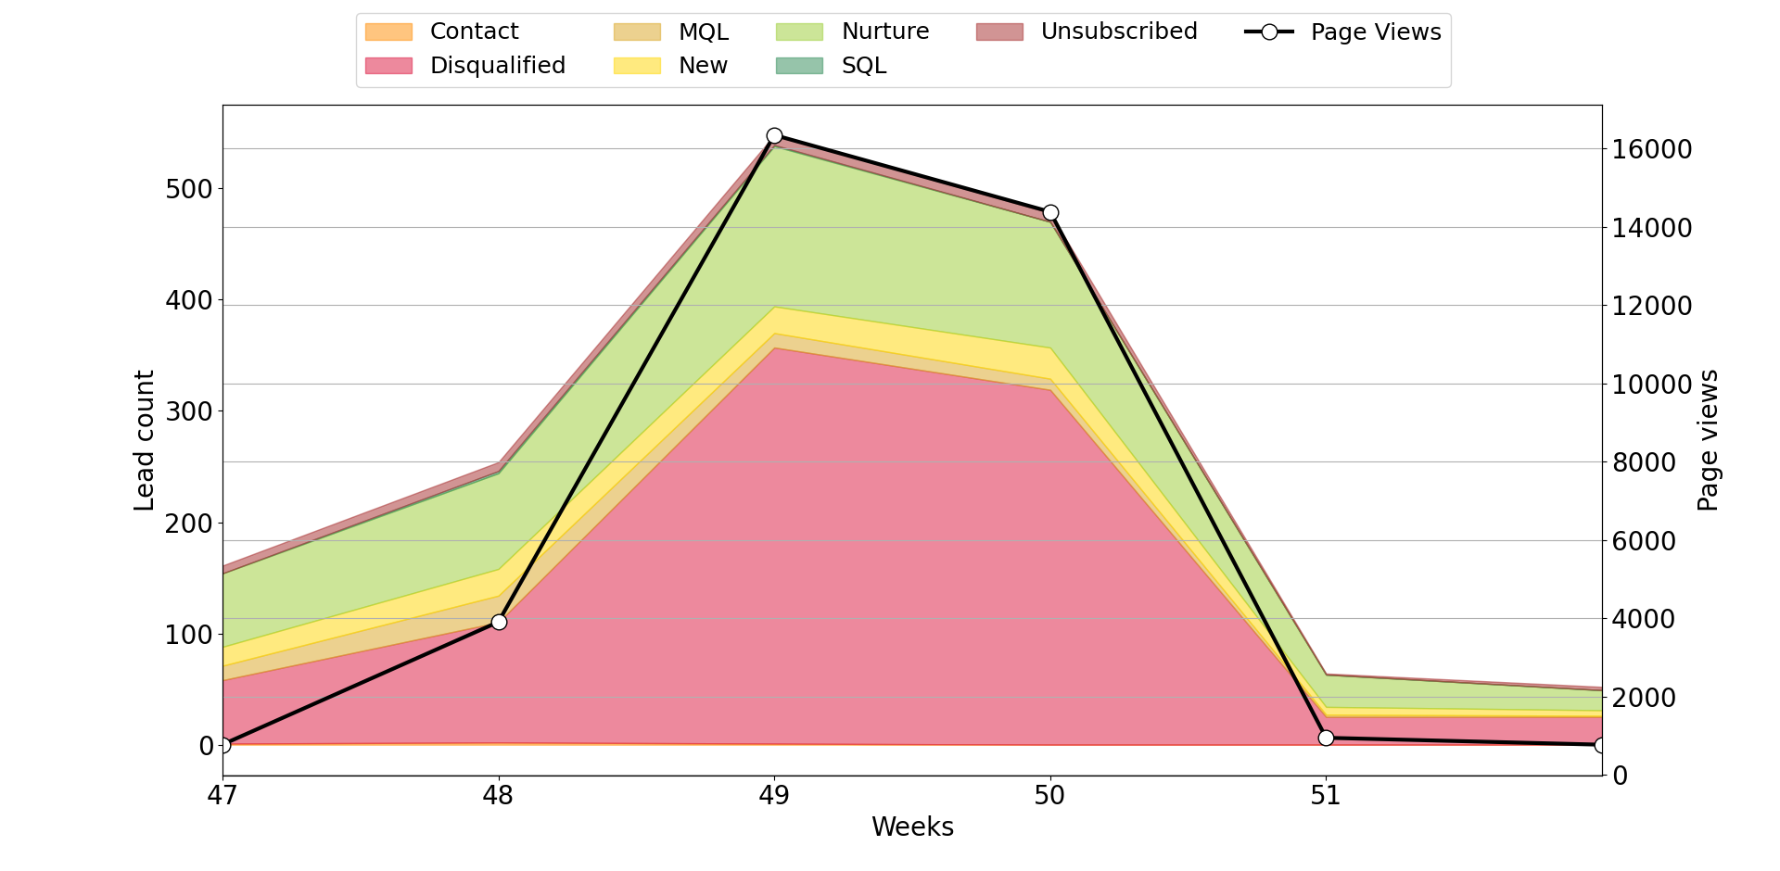
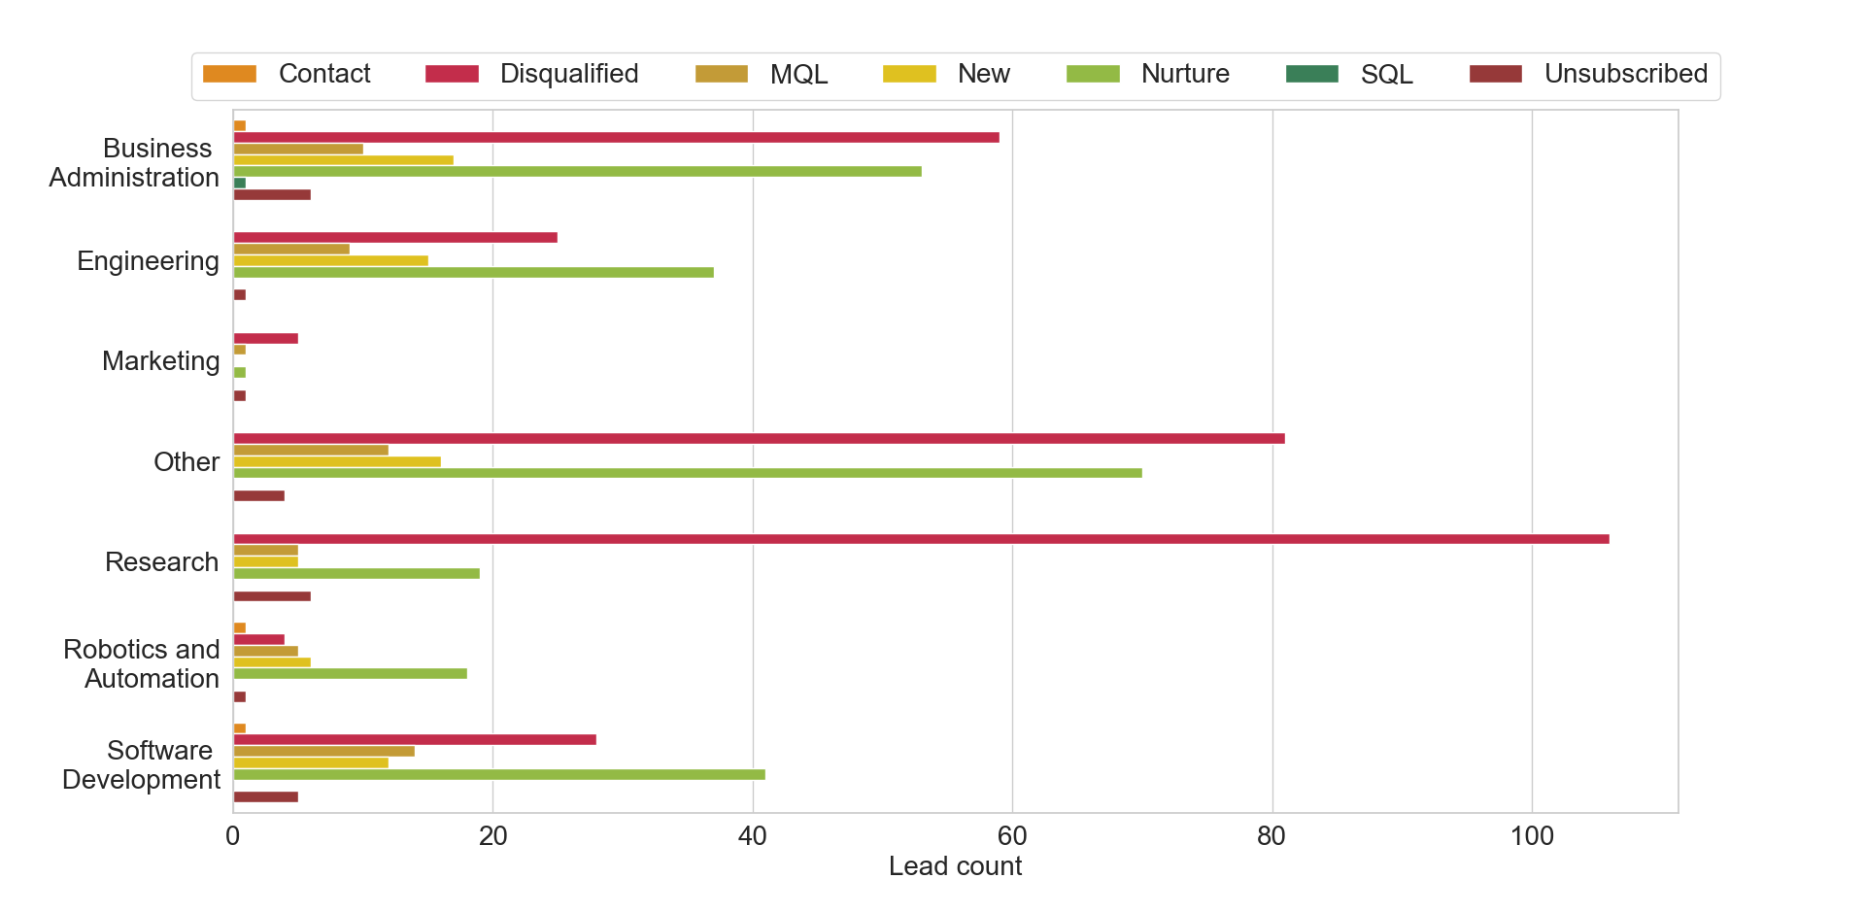
PAGE VIEWS
PAGE VIEWS
LEADS
AVG SESSION
BOUNCE RATE
37122
2048
1557
00:01:13
78.97%
AVG VISUALIZATION TIME And BOUNCE RATE Per Week
LEADS Status Breakdown
LEADS Status Per SOURCE
PAGE VIEWS And Acquired LEADS Per Week
LEADS Status Per Professional Domains
Country | MQL | New | Nurture | SQL | Total
US | 25 | 22 | 59 | 2 | 108
CN | - | 4 | 94 | - | 98
IN | 1 | 5 | 26 | - | 32
GB | 2 | 10 | 12 | - | 24
IT | 4 | 5 | 14 | - | 23
Country | Disqualified | Unsubscribed | Total
CN | 597 | 3 | 600
US | 56 | 6 | 62
IN | 14 | 2 | 16
GB | 12 | 4 | 16
RU | 11 | 1 | 12

Slide 11
What worked and what didn’t
Low amount of quality leads, which might be connected to 1) non-effective targeting and/or 2) low interest in the topic
60% of total leads are Disqualified, Contact and Unsubscribed
Highest average bounce rate
Leads coming from Google paid are classified as Disqualified

Slide 12
Campaign 4

Slide 13
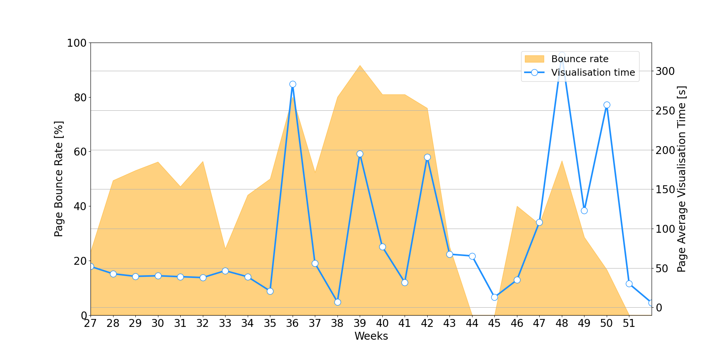
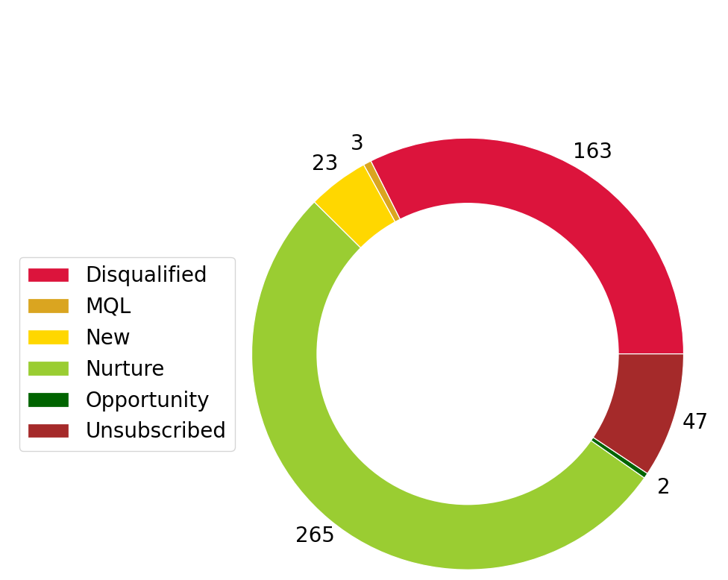
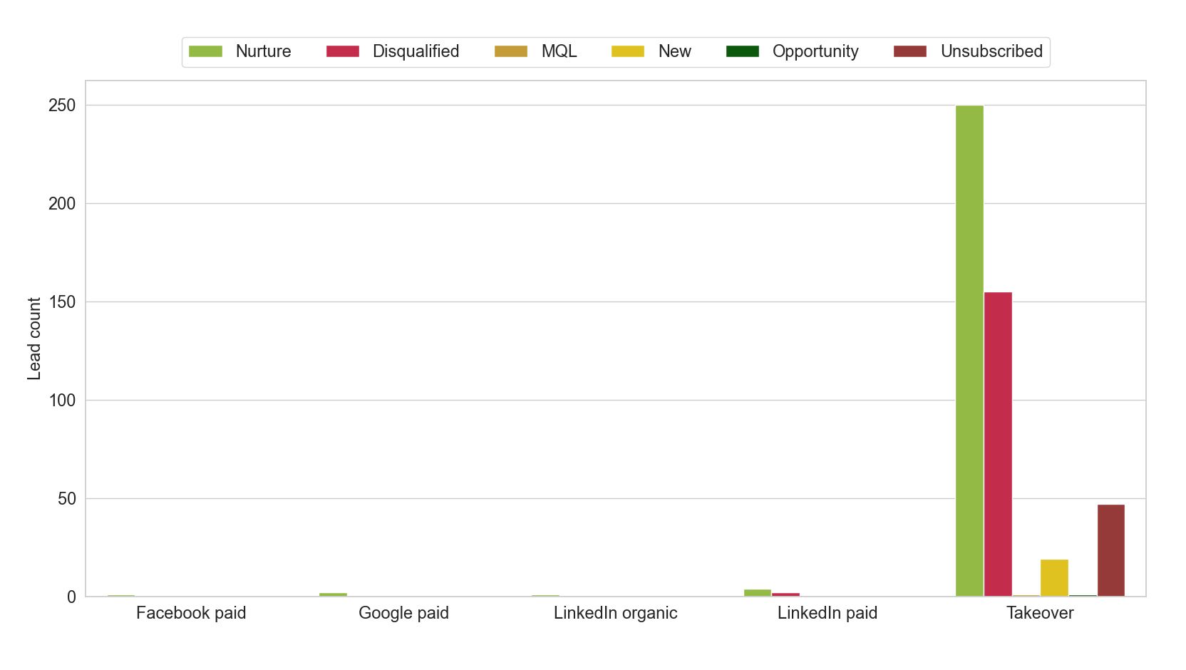
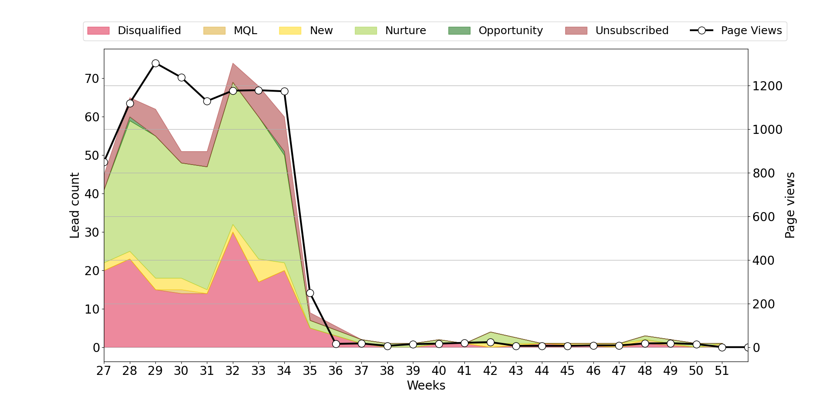
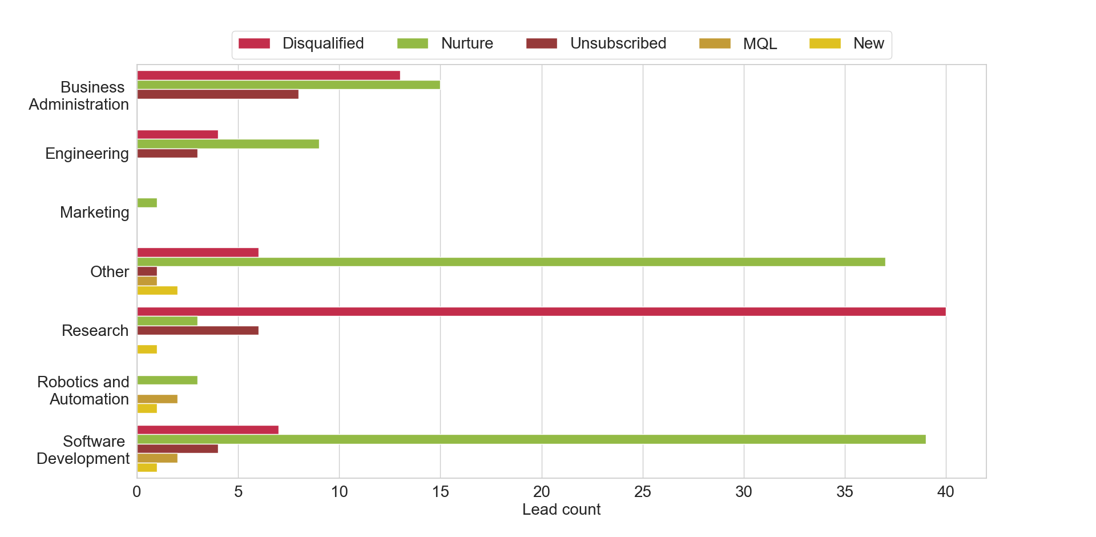
PAGE VIEWS
PAGE VIEWS
LEADS
AVG SESSION
BOUNCE RATE
9630
2048
503
00:01:27
49.14%
AVG VISUALIZATION TIME And BOUNCE RATE Per Week
LEADS Status Breakdown
LEADS Status Per SOURCE
PAGE VIEWS And Acquired LEADS Per Week
LEADS Status Per Professional Domains
Country | MQL | New | Nurture | Total
US | 2 | 2 | 19 | 23
IN | - | - | 19 | 19
BR | - | 1 | 9 | 10
ID | - | - | 8 | 8
MX | - | 1 | 6 | 7
Country | Disqualified | Unsubscribed | Total
US | 22 | 5 | 27
MX | 7 | 1 | 8
IN | 4 | 2 | 6
AR | 2 | 2 | 4
CA | 2 | 2 | 4

Slide 14
What worked and what didn’t
Good targeting, as highest number of Nurture belongs to SWD
Drop in the page views and leads after a few weeks
Lowest average bounce rate
High number of Nurture leads collected from non-potential customers (Other category)

Slide 15
With additional data
With the information on the unique viewers, it might have been possible to compute the lead conversion rate
1
Information on key words and type of content (post, video, etc.) might have been correlated with the lead status, to understand which content drives the highest number of quality leads
2
Information on the device (PC, smartphone) might have been correlated with the bounce rate
3
Information on the budget and communication strategy (media channels) might have been correlated with the effectiveness of the campaign
4

